Slide 1


Property Price Guide (London version)
Xccelerate DSML -
Web Scraping Project
Subba Chuda Kumari

Slide 2

Content
Aim & Value
Data Collection & Preprocessing
Observations & Findings
Challenges or Limitations
Conclusion/ Next steps

Slide 3
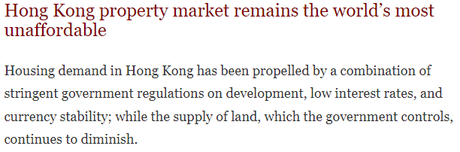
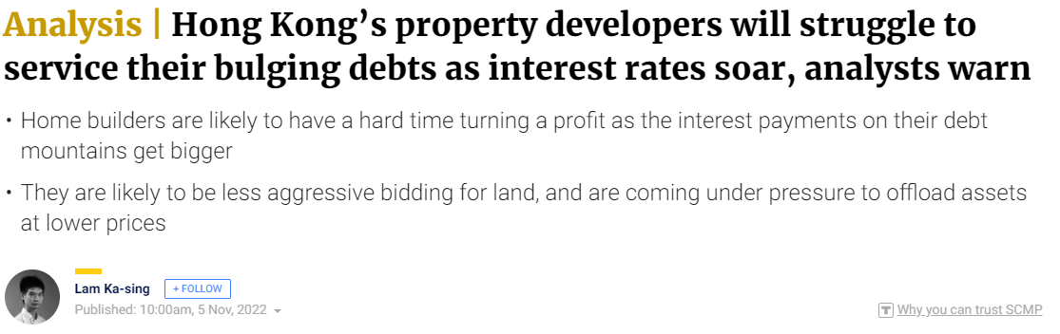
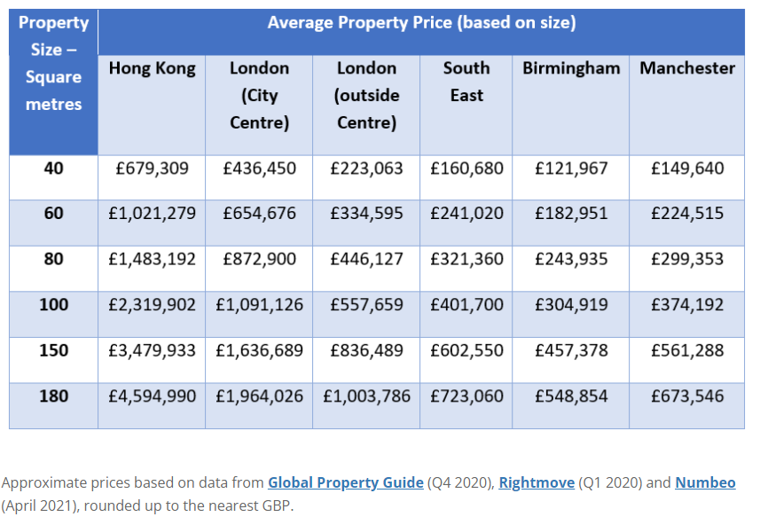
Aim & Value
Assist in informed decision making when purchasing a property
Shows guided fair price that one should be paying or receiving
Made for property buyers/ sellers

Slide 4

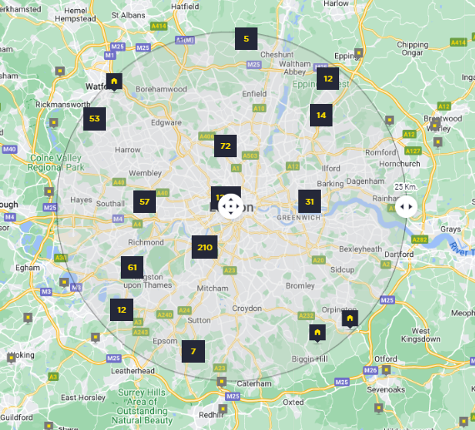
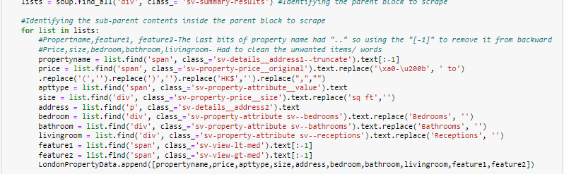
Data Collection & Preprocessing
jupyternotebook
Data Collection
Savills Website
All London properties available
Houses/ Flats & Apartments/ New developments/ Penthouse
Data Preprocessing
Done in parallel while collecting data
Remove unwanted characters/ Include spaces
Ensure no null values or faulty points
*Workings in jupyternotebook

Slide 5
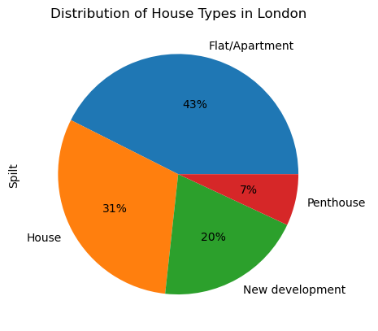
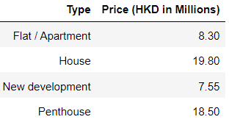
Observations - Based on Savills data..
(1) Distribution of property type
(2) Fair price guide for London property data
(median score)
*Pie chart made with pandas library
*Complete dataset included in csv and jupyternotebook

Slide 6
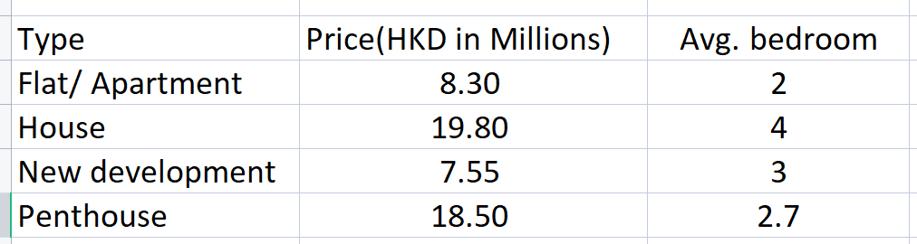
Findings - Based on Savills data..
(3) Average bedroom sizes according to fair price guide (median score)
Comparatively, you could be much better off buying a newly developed property

Slide 7
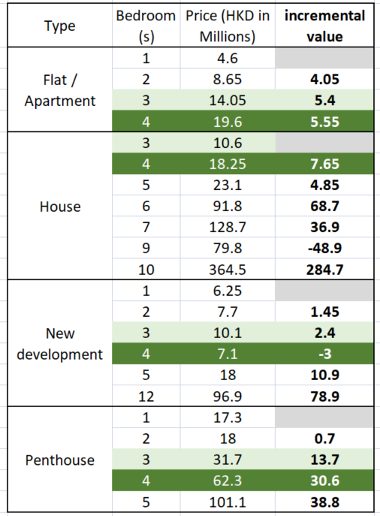
Findings - Based on Savills data..
(4) Incremental value of property type price by bedroom(s) (median)
When digging deeper of the property type by bedrooms, the price of a newly developed 3 bedroom remains the lowest but price of house trails closely
Instead, one can find the optimal value in purchasing a newly developed 4 bedroom property. The relative pricing lags behind against other types.

Slide 8
Challenges/ Limitations
Currently not entirely representative of London: The findings/ data is only based on 1 data provider (Savills)
Some real estate websites were not scrapable (403, 503)

Slide 9
Conclusion/ Next steps
Based on Savills data, it could be worth purchasing a newly developed 4 bedroom property.
Additional desk research for market context for investment
Continue building the fair price database by including other data providers

Slide 10
Thank you

